Slide 1

2025 Wellbeing Solutions
Whole-person care to help improve health outcomes, simplify healthcare, and increase value

Slide 2


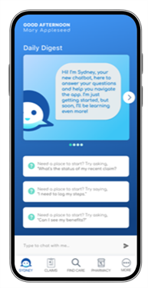

Sydney Health mobile app
Download Sydney Health and register on the app to take full advantage of your Anthem plan.
Find care and check costs.
See all benefits.
View claims and payment information.
View and use digital ID cards.
Manage prescription orders and refills.
Get answers quickly with the interactive chat feature.
Access Telehealth .
Access wellness resources and rewards.
Sync with your fitness tracker.
Reach Member Services for support.
Track your meals with our Nutrition Tracker
Notes:
The Sydney Health mobile app keeps your healthcare information in one convenient place. And it’s personalized.
You can use it to:
Find a healthcare professional or facility in your plan’s network.
See ratings and reviews for doctors and hospitals.
See all your benefits and plan details.
View your claims and compare costs.
Access your ID card to show at the doctor or pharmacy.
Manage prescription orders and refills.
Get answers quickly with the interactive chat feature, or access virtual care.
Check out wellness resources and rewards.
Sync with your fitness tracker, and
Contact Member Services for support.

Slide 3

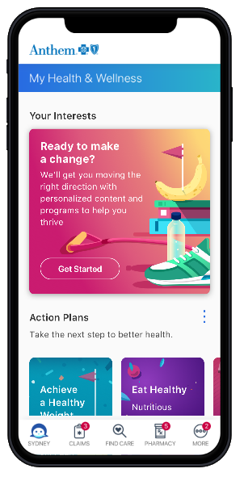
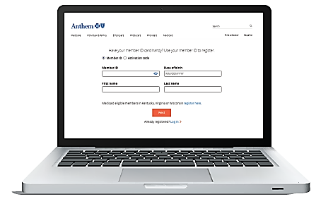
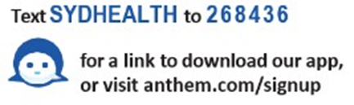


If you haven’t done so already…Register Today!
Got to Anthem.com/register
Provide the information requested
Create a username and password
Set your email preferences
Follow the prompts to complete your registration
Download the free Sydney mobile app and Select Register
Confirm your identity
Create a username and password
Confirm your email preferences
Follow the prompts to complete your registration
3
Need help signing up? Call your member services number on the back of your Anthem ID card.
Notes:
It is not enough for a health plan to blindly connect data—those insights need to work harder. For true, lasting transformation in healthcare, it takes learning, listening, and gaining an unprecedented line of sight into the health journey of each individual member.
At Anthem, our ecosystem is built around this customer journey, with every piece connected by a single purpose: installing everyone with the confidence of care.
Anthem partners with local experts to overcome some of the toughest health challenges people are facing. We do it through unique combination of technology and empathy — allowing us to re-invent how we deliver health today and tomorrow.
Here are some of the ways we are working to move people, business, and healthcare forward.
Digital-first ecosystem
We believe the future of healthcare is a thriving, interconnected ecosystem fed by data and digital. Where technology makes the human experience more cohesive. In this kind of health ecosystem, all aspects of healthcare—doctors, health plans, wellness tools, everything—work together seamlessly to create more efficient and effective care, and a more connected experience for everyone. At Anthem, we are actively working to build the healthcare ecosystem of tomorrow, right now.
Human-focused data and artificial intelligence
Data is meaningless unless you recognize that there is a real person behind each datapoint. With Anthem, you have a health plan that’s harnessing the power of artificial intelligence (AI) and data science to improve every moment of health—informing the way we collaborate with providers, customize networks, unify the member experience, and reduce the total cost of care.
Health in real time
As we touched on earlier, every moment is an opportunity to learn and impact a person’s health. At Anthem, those opportunities do not go to waste. Using real-time population health analytics, we are meeting members where they are, when they need us most, to improve health—and keep costs down—proactively.
Tools that power life
Finally, we have smarter, more human-centered tools that can impact members’ real lives, right now. It is all anchored by digital experiences, like apps, that combine the power of artificial intelligence with the emotional intelligence of a real person. A person who is always there to help.

Slide 4


ConditionCare support
24/7 access to a nurse care manager if you have:
Asthma (Pediatric & Adult)
COPD
Diabetes (Pediatric & Adult, Type I & II)
Heart Disease or
Heart Failure
The nurse care manager can help you:
Manage your condition.
Follow your doctor’s care plan.
Provide information to help you recover.
You also have additional support from dietitians, health educators, and pharmacists.
Notes:
If you have lower back pain, vascular disease, or a musculoskeletal disorder, ConditionCare gives you 24/7 access to a nurse care manager. The care manager can help you follow your doctor’s care plan and manage your condition so you can recover.

Slide 5



Building Healthy Families
Access to screenings, tools, and trackers for preconception/fertility, pregnancy, and children through age five (and beyond)
Digital program available 24/7 through our Sydney SM Health mobile app
Extensive content library covering topics to support diverse families on their path to parenthood including single parents and same-sex or multicultural couples
Notes:
This digital program can help support your family from preconception through the stages of pregnancy, childbirth, and early childhood (to age 5 and beyond).
It is available 24/7 through our Sydney Health mobile app and features an extensive content library covering topics to support diverse families, including single parents and same-sex or multicultural couples.
In addition, the app features many tools including fertility, diaper change, and feeding trackers, due date calculators, and blood pressure monitoring.
Visit the Sydney Health app to enroll today.

Slide 6

Cancer Care Navigators
Our multidisciplinary Oncology Case Management team can connect members to the whole-person care they need ‒ where and when they need it most.
Cancer Care Navigators act as a single point of contact for members and their care teams, and can answer questions about care and benefits.
Oncology-focused nurse coaches strive to provide education and seamless care coordination.
Registered dieticians help members with special or modified nutritional requirements.
Behavioral health experts help enhance members’ emotional well-being.
* EAP services and disability coverage are available at an additional cost.
Notes:
Because the cancer treatment journey can be complex, our case managers are available to offer support to members and address questions.
We identify members beginning chemotherapy who may benefit from additional support. Our case managers, who have completed Anthem’s oncology certification, educate members, conduct ongoing health assessments and coordinate with a multidisciplinary team to ensure every member receives seamless care. For cancer patients with specialized dietary requirements, our registered dieticians develop customized meal plans and provide guidance on navigating specialized nutritional needs. Our behavioral health experts work with members to address they psycho-social needs.
And our support doesn’t stop there: our team creates custom plans based on member responses to our oncology, symptom and palliative care needs assessments.
When clients purchase Anthem EAP and Disability coverage, the patient and their household have access to financial and emotional counseling and have a financial safety net while they are undergoing treatment. Fear, anxiety, and financial hardships are all very common among cancer patients and these extra benefits can help minimize the impact.
It all adds up to a more comprehensive approach to the biggest battle our members may ever face.

Slide 7
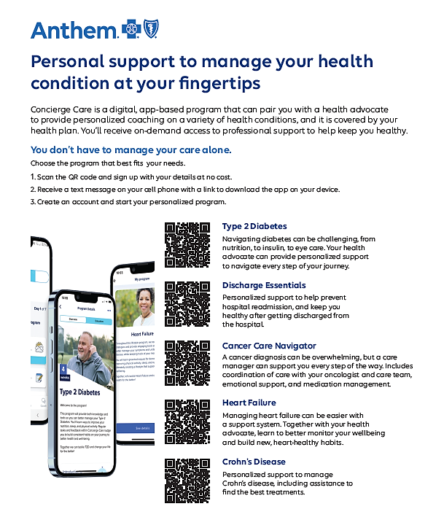
Digital Concierge Care
Type 2 Diabetes
Hospital Discharge
Cancer
Heart Failure
Crohn’s Disease

Slide 8

Diabetes Prevention Program
The 12-month weight loss program can help you lose weight and reduce your risk for diabetes.
Anthem and Lark have come together to offer this program at no extra cost. It is part of your health plan.
It’s customized to your lifestyle, so you receive 24/7 coaching to:
Lose weight
Manage stress
Eat healthier
Sleep better
Increase activity
Eligible participants:
OR from Sydney app → More Tab → My Health Dashboard and searching for Lark Diabetes Prevention Program under Programs.
age 18+
can enroll in a DPP to help adopt healthier lifestyle habits.
Notes:
The 12-month weight loss program is a longer, more extensive version of the 16-week program. It includes 24/7 coaching for weight loss, healthy eating, stress management, and exercise.

Slide 9

Emotional Wellbeing Resources
Programs Section ➔ Emotional Wellbeing Resources
Learn to Live Video
Personalized care modules promote skill-building, resiliency and mindfulness
Combines live coaching with caring clinicians and online Cognitive Behavioral Therapy (CBT) lessons to
Peer- to –peer communities encourage additional social support
Interactive Modules Stress Depression Anxiety Substance abuse Chronic Pain Insomnia | User Customization Assessment Profile Motivation User Preferences | Mind+Body+ Spirit Resources Wellness Spiritual Social and Community
Cognitive Behavioral Therapy
Behavioral Activation
Mindfulness
Motivational Interviewing
Positive Psychology
Notes:
This 16-week program can help you lose weight and reduce your risk of developing diabetes. You can choose from support services such as Weight Watchers or HealthSlate. The programs include access to a health coach, a meal planner, small group support, weekly lessons, and a wireless scale or activity tracker.

Slide 10
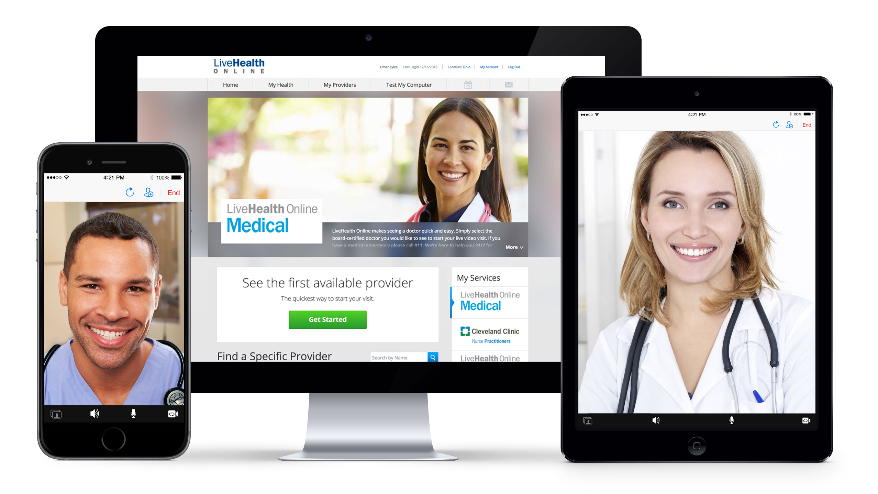


Access Telehealth
Connect with care anywhere
Text base of Video Based telehealth appointments on your mobile phone, tablet, or computer with a camera
Board-certified doctors available 24/7 for advice, treatment, and prescriptions
See a licensed therapist or psychiatrist..
Appointments are available 7 days a week and usually cost the same as an in-person visit.
Cost is less than or equal to an in-person office visit
To make a virtual care appointment, in your Sydney app, choose Virtual Care under Care.
10
Notes:
Your plan comes with a virtual care option so you can see a doctor <or therapist> using your smartphone, tablet, or computer with a camera. With your telehealth option, you can:
Have 24/7 access to doctors in about 10 minutes or less. The doctors can assess your condition and send prescriptions to your pharmacy, if needed. It's a great choice when your doctor isn't available for things like pinkeye, the flu, a cold, a sinus infection, or other common health conditions.
<See a licensed therapist. If you're stressed, anxious, or having a tough time, you can talk with a therapist online. In most cases, you can make an appointment and see a therapist in four days or less. Appointments are available seven days a week, and a 45-minute session usually costs about the same as an office therapy visit.>
<See a psychiatrist online. Unlike therapists, who offer counseling support, psychiatrists are available to provide an evaluation and medication management if needed. You can typically arrange a virtual visit with a psychiatrist within 14 days or less.>

Slide 11

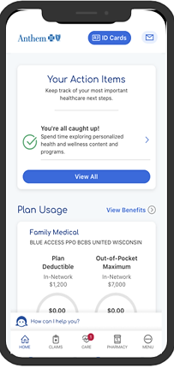
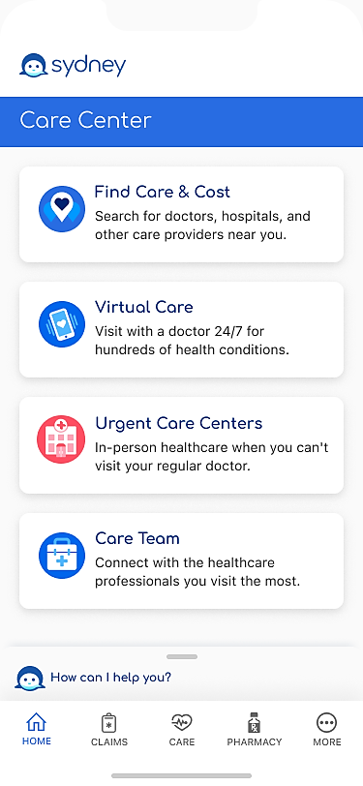
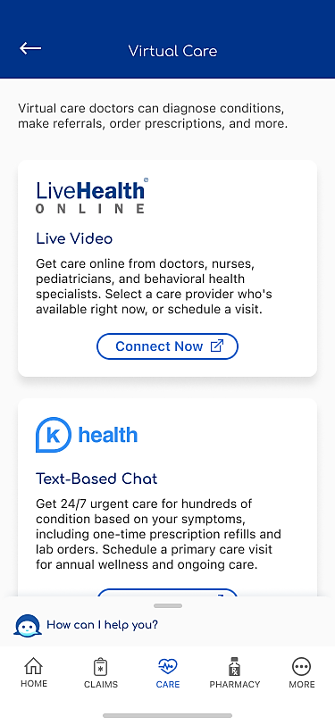
Virtual Care Center
LHO Virtual Primary Care:
Primarily Video Based, >12+ yrs old
Urgent Care
Annual Wellness Exams
Primary Care Visits
Psychology & Psychiatry visits
Members can choose and establish an ongoing relationship with a provider for primary care needs
Labs,/Imaging, e-prescriptions & refills, in network provider referrals
K Health:
Primarily Text Base, > 18 yrs od
Symptom Checker
Urgent Care
Annual Wellness Exams
Primary Care Visits
Members are directed to Khealth’s app, which allows members to:
Receive improved quality and performance
Schedule a visit with a provider of choice
Navigate chat history and care plans more easily

Slide 12


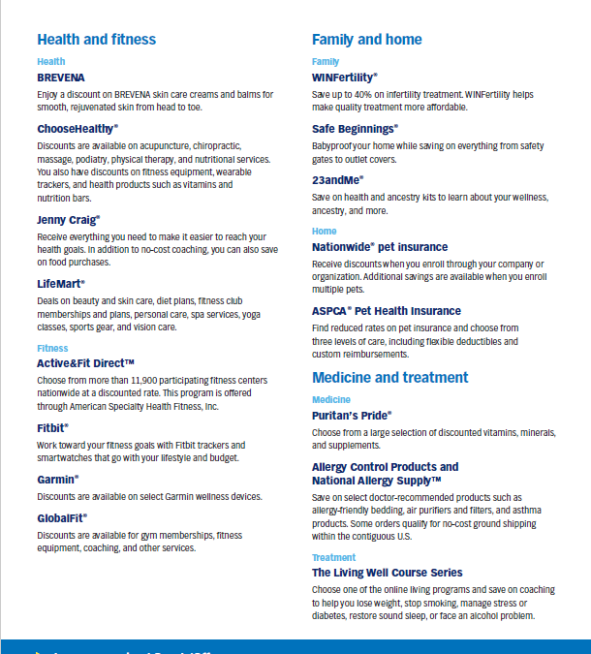
SpecialOffers
Visit anthem.com and choose Discounts to:
Save money on glasses, weight loss programs, gym memberships, and vitamins.
12
Notes:
Your plan comes with special offers and discounts. You can save money on goods and services, such as glasses, fitness memberships, vitamins, hearing aids, and weight-loss programs.

Slide 13

Thank You!

